Slide 1
Local search algorithms

Slide 2
Local search algorithms
In many optimization problems, the path to the goal is not relevant; finding the goal state is sufficient
State space = set of "complete" configurations
Example: n-queens
In such cases, we can use local search algorithms
keep a single "current" state, tries to improve it
all previous states can be discarded
since only information about the current state is kept, such methods are called local

Slide 3
Local search algorithms
Local search = use single current state and move to neighboring states.
Some examples:
Hill climbing
Simulated annealing
Constraint satisfaction
Advantages:
Use very little memory
Find often reasonable solutions in large or infinite state spaces.

Slide 4
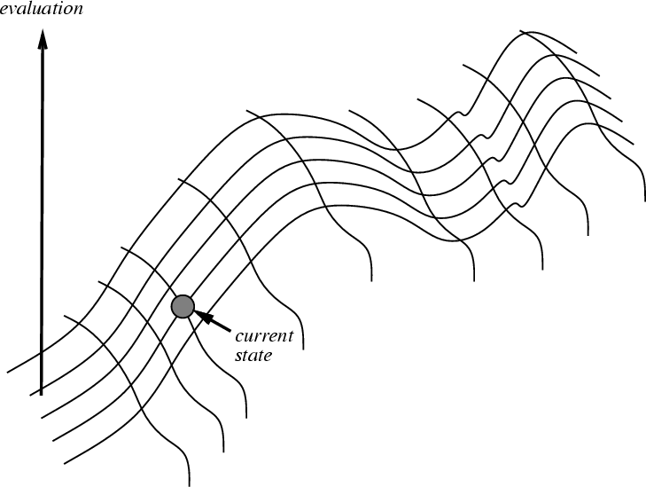
Hill Climbing on a Surface of States
Height Defined by Evaluation Function
Notes:
‹#›

Slide 5
Hill Climbing Search
Search technique that continuously moves uphill (increasing value of an evaluation function h)
Terminates when a peak is reached
If there exists a neighbor s for the current state n such that
h(s) < h(n)
h(s) ≤ h(t) for all the neighbors t of n,
then move from n to s. Otherwise, halt at n.
Looks one step ahead to determine if any neighbor is better than the current state; if there is, move to the best neighbor.
Does not look “beyond the neighbors”
Similar to Greedy search in that it uses h, but does not allow backtracking or jumping to an alternative path since it doesn’t “remember” where it has been.
Notes:
‹#›

Slide 6
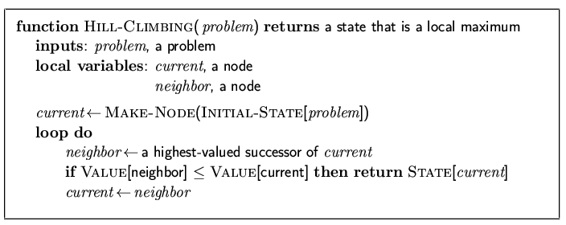
Hill-climbing search
"Like a blind man climbing mount Everest"

Slide 7
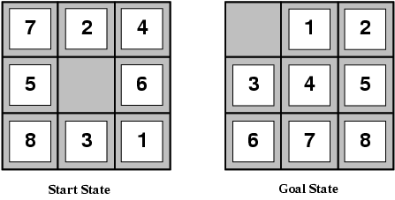
8-puzzle (here we go again)
states? locations of tiles
actions? move blank left, right, up, down
goal test? = goal state (given)
path cost? 1 per move
[Note: optimal solution of n-Puzzle family is NP-hard]

Slide 8
8-puzzle (here we go again)
Remember the heuristics?
h₁(n) = number of misplaced tiles
h₂(n) = total Manhattan distance
(i.e., no. of squares from desired location of each tile)
h₁(S) = ? 8
h₂(S) = ? 3+1+2+2+2+3+3+2 = 18

Slide 9
Hill Climbing Example
2
8
3
1
2
3
start
1
6
4
h = -4
goal
8
4
h = 0
7
5
7
6
5
-5
-5
-2
2
8
3
1
2
3
1
4
h = -3
8
4
h = -1
7
6
5
7
6
5
-3
-4
2
3
2
3
1
8
4
1
8
4
h = -2
7
6
5
7
6
5
h = -3
-4
f(n) = -(number of tiles out of place)
Notes:
‹#›

Slide 10
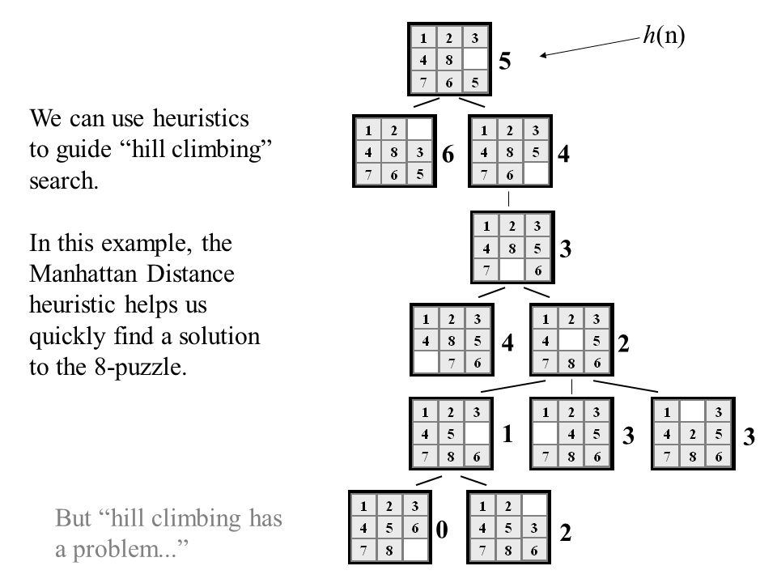
Hill Climbing Example
Hill climbing with minimization goal:
Here, the objective function is
min f Where, f = h(n)=(manhattan distance)

Slide 11
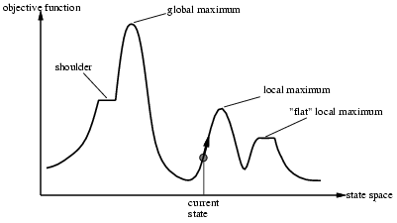
Drawbacks of Hill-climbing search
Problem: depending on initial state, can get stuck in local maxima

Slide 12
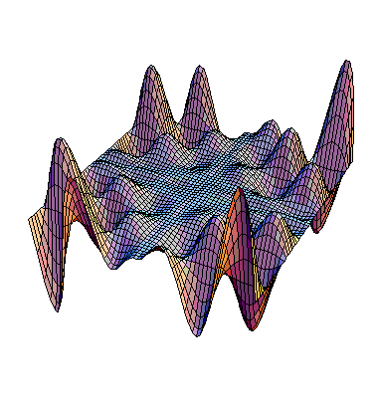
Exploring the Landscape
local maximum
Local Maxima: peaks that aren’t the highest point in the space
Plateaus: the space has a broad flat region that gives the search algorithm no direction (random walk)
Ridges: flat like a plateau, but with drop-offs to the sides; steps to the North, East, South and West may go down, but a step to the NW may go up.
plateau
ridge
Image from: http://classes.yale.edu/fractals/CA/GA/Fitness/Fitness.html
Notes:
‹#›

Slide 13
Example of a Local Optimum
1
2
5
7
4
f = -7
start
move
up
goal
8
6
3
1
2
5
1
2
3
8
7
4
8
4
f = 0
move
right
6
3
7
6
5
f = -6
1
2
5
Local Maxima
8
7
4
f = -7
f = -(manhattan distance)
6
3
Plateaus
Notes:
‹#›

Slide 14

Example: n-queens
Put n queens on an n × n board with no two queens on the same row, column, or diagonal

Slide 15
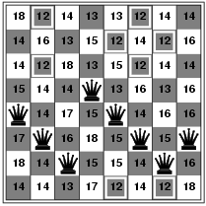
Hill-climbing search: 8-queens problem
h = number of pairs of queens that are attacking each other, either directly or indirectly
h = 17 for the above state

Slide 16
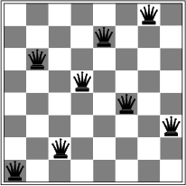
Hill-climbing search: 8-queens problem
A local minimum with h = 1

Slide 17
Remedies of Hill Climbing Search
Problems: local maxima, plateaus, ridges
Remedies:
Random restart: keep restarting the search from random locations until a goal is found.
Accept worse neighbours: even if neighbour is worse, accept with some fixed probability p
Simulated Annealing
Some problem spaces are great for hill climbing and others are terrible.
Notes:
‹#›

Slide 18
Simulated Annealing
Idea: escape local maxima by allowing some "bad" moves but gradually decrease their frequency
The algorithm is based on the metallurgical process of annealing, which is used to strengthen metals or remove internal stresses
Metal is first heated to a high temperature so that its atoms can move freely
Then the metal is slowly cooled down so that the atoms gradually settle into a stable, low-energy crystal structure
Bouncing ball analogy
Shaking hard (= high temperature)
Shaking less (= lower the temperature)
Notes:
‹#›

Slide 19
Simulated Annealing
Notes:
‹#›

Slide 20
Simulated Annealing
SA uses a random search that accepts changes that increase objective function f, as well as some that decrease it
SA uses a control parameter T, which by analogy with the original application is known as the system “temperature”
T starts out high and gradually decreases toward 0.
If T decreases slowly enough, best state is reached
Notes:
‹#›

Slide 21
Simulated annealing
function SIMULATED-ANNEALING(problem, schedule) return a solution state
input: problem, a problem
schedule, a mapping from time to temperature
local variables: current, a node.
next, a node.
T, a “temperature” controlling the probability of downward steps
current ← MAKE-NODE(INITIAL-STATE[problem])
for t ← 1 to ∞ do
T ← schedule[t]
if T = 0 then return current
next ← a randomly selected successor of current
∆E ← VALUE[next] - VALUE[current]
if ∆E > 0 then current ← next
else current ← next only with probability e^{∆E /T}

Slide 22
Simulated annealing
Time | Temperature | ∆E | Probability= e^{∆E /T}
1 | 30 | -2 | 0.93551
2 | 20 | -2 | 0.90484
3 | 10 | -2 | 0.81873
4 | 9 | -2 | 0.80074
5 | 8 | -2 | 0.7788
6 | 7 | -2 | 0.75148
7 | 6 | -2 | 0.71653
Time | Temperature | ∆E | Probability= e^{∆E /T}
8 | 5 | -2 | 0.67032
9 | 4 | -2 | 0.60653
10 | 3 | -2 | 0.51342
11 | 2 | -2 | 0.36788
12 | 1 | -2 | 0.13534
13 | 0 | -2 | 0

Slide 23
Simulated Annealing (cont.)
Note that for a “bad” move ∆E will be negative, so bad moves always have a relatively probability less than one.
Good moves, for which ∆E is positive, have a relative probability greater than one.
The higher the temperature, the more likely it is that a bad move can be made.
As T tends to zero, this probability tends to zero, and SA becomes more like hill climbing
If T is lowered slowly enough, SA is complete and admissible.
Notes:
‹#›

Slide 24
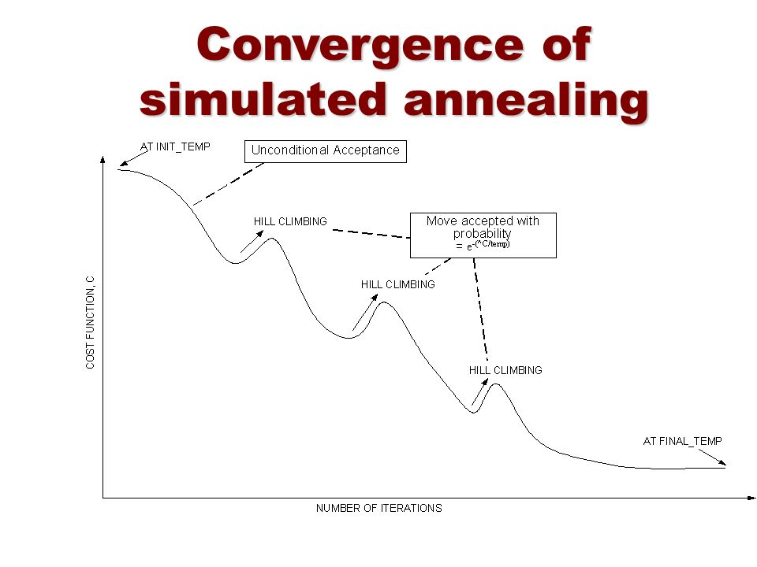

Slide 25
Properties of simulated annealing search
One can prove: If T decreases slowly enough (infinitely slowly), then simulated annealing search will find a global optimum with probability approaching 1 [complete and optimal]
This would require letting SA run for infinite (very long) time – defeats the purpose
Widely used in VLSI layout, airline scheduling, etc

Slide 26
Local search vs A* search
A* search needs to know the goal state, local search does not
A* finds the path to goal, local search does not
What else?
Think about search strategy, memory usage, completeness, optimality

